Slide 1



Nessus & Burp Suite
Presented by:
Irfanullah
M Yamin

Slide 2
Agenda
Introduction
Background
Architecture
Features
Setup & Installation
Working demo

Slide 3


Slide 4
Introduction
An open-source network vulnerability scanner
Developed by Tenable Inc.
Built using Nessus Attack Scripting Language (NASL)
NASL describes individual threats and potential attacks
It can run over 1200 checks on a given computer
Notes:
Nessus is a remote security scanning tool, which scans a computer and raises an alert if it discovers any vulnerabilities that malicious hackers could use to gain access to any computer you have connected to a network.

Slide 5
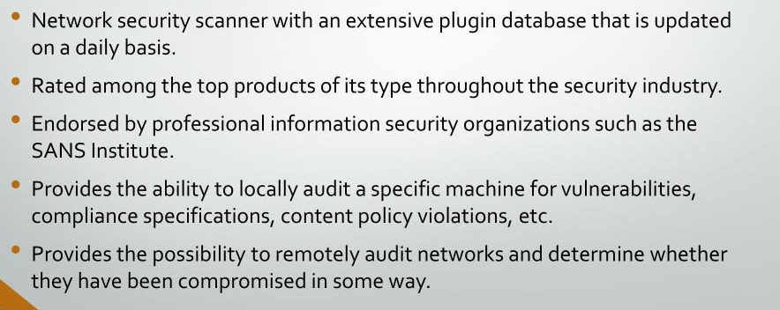
Background

Slide 6
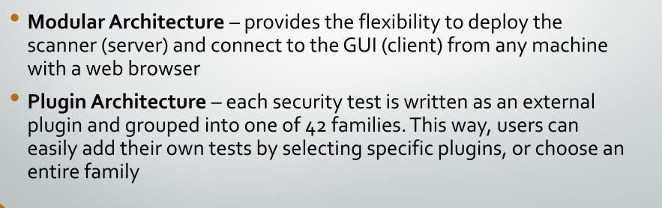
Architecture

Slide 7
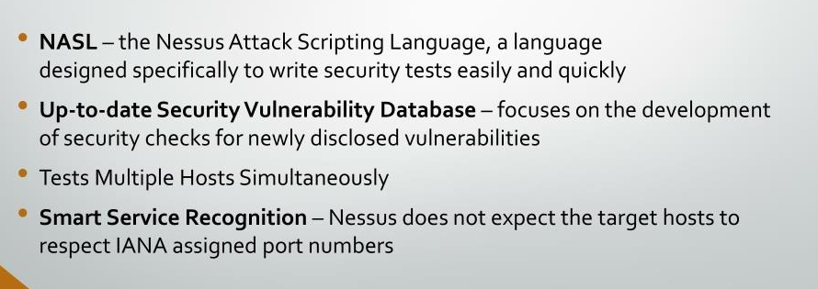
Features

Slide 8
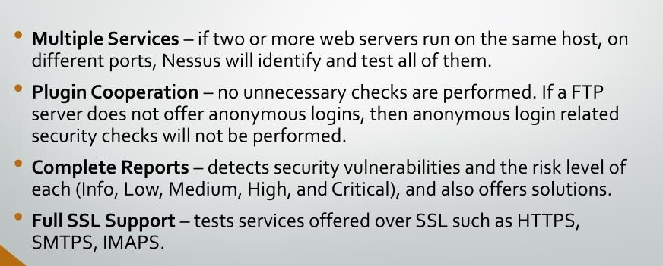
Features cont.

Slide 9
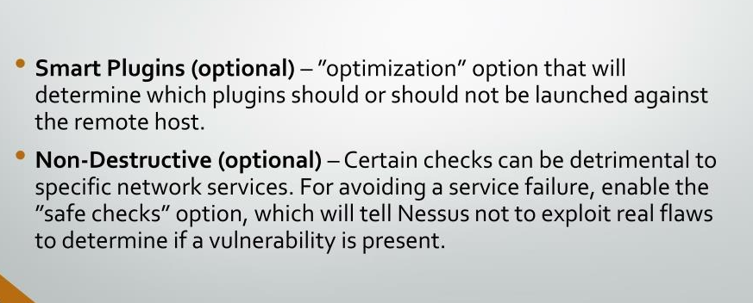
Features cont.

Slide 10
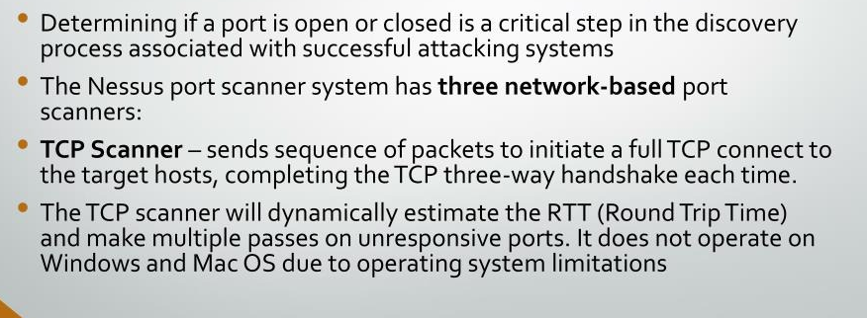
The Nessus Port Scanning Engine

Slide 11
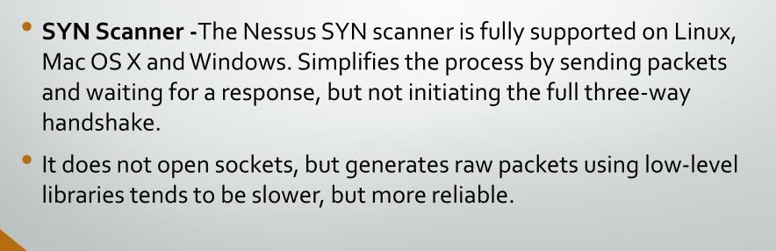
The Nessus Port Scanning Engine

Slide 12
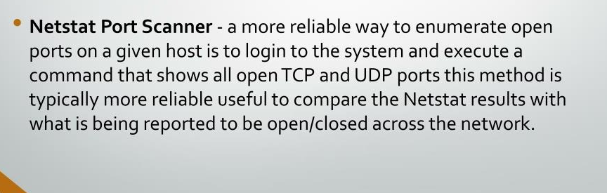
The Nessus Port Scanning Engine

Slide 13
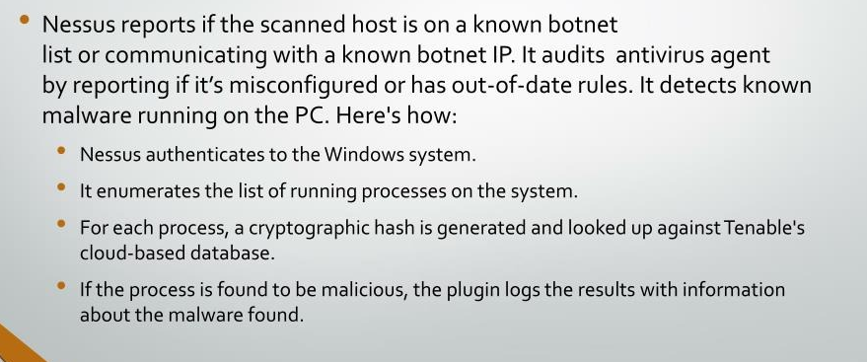
Windows Malware Scan

Slide 14
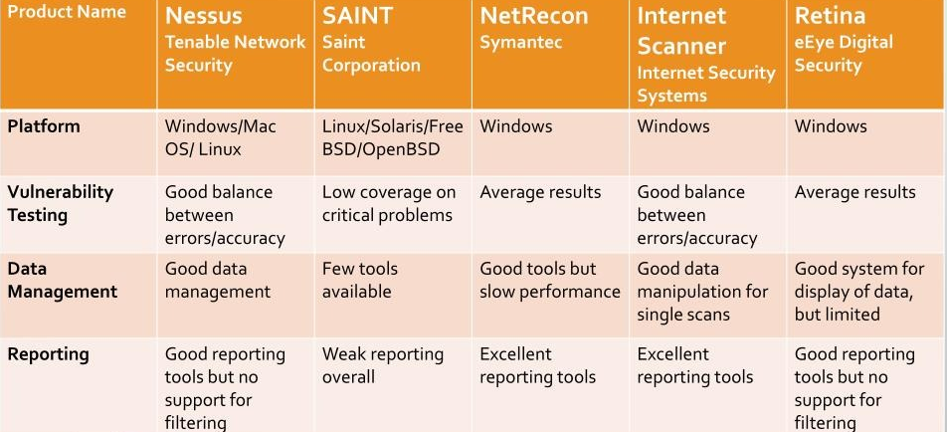
Vulnerability Scanners Analysis

Slide 15
Setup and Installation
Search "Nessus Essentials" on your browser
Go on Tenable official website
Create an account to get activation code
Download and install Nessus
Enter activation code and get started

Slide 16
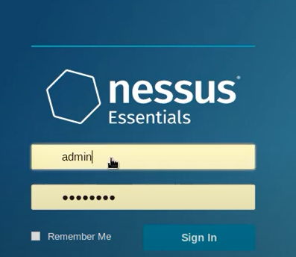
Working Demo
Create account

Slide 17
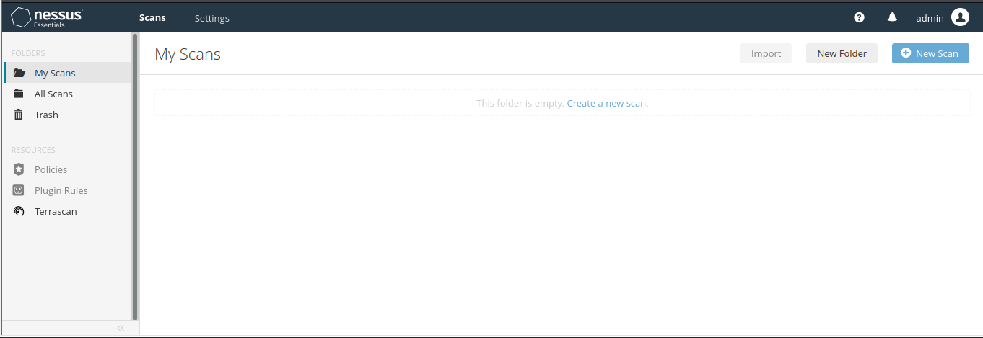
Dashboard

Slide 18
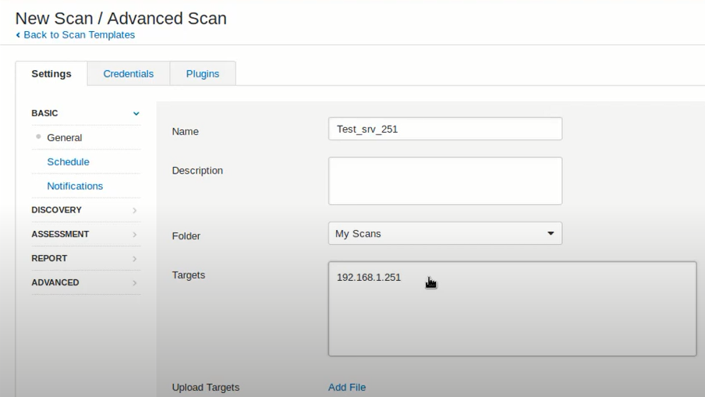
Create New Scan

Slide 19
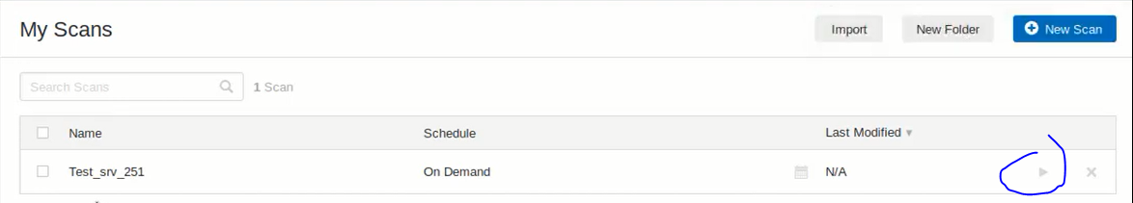
Launch the Scan

Slide 20
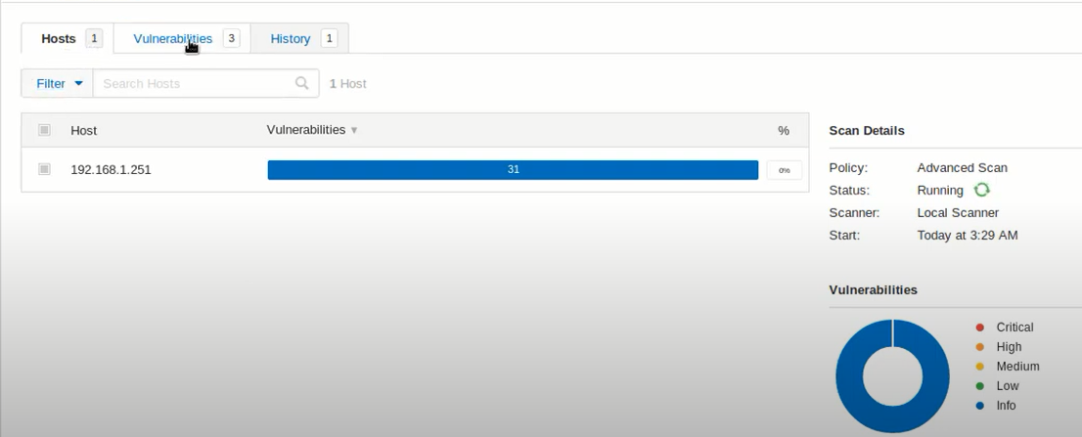
Results

Slide 21
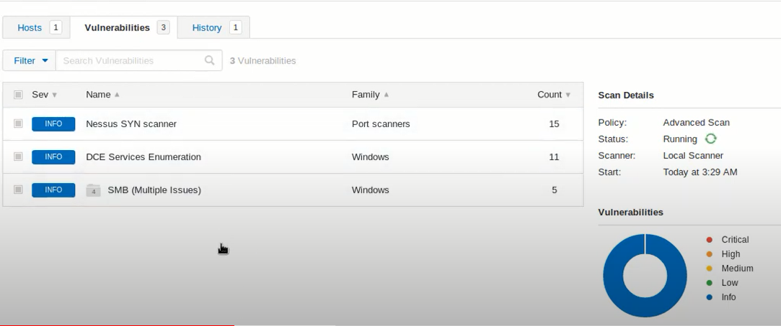
Check Vulnerabilities

Slide 22
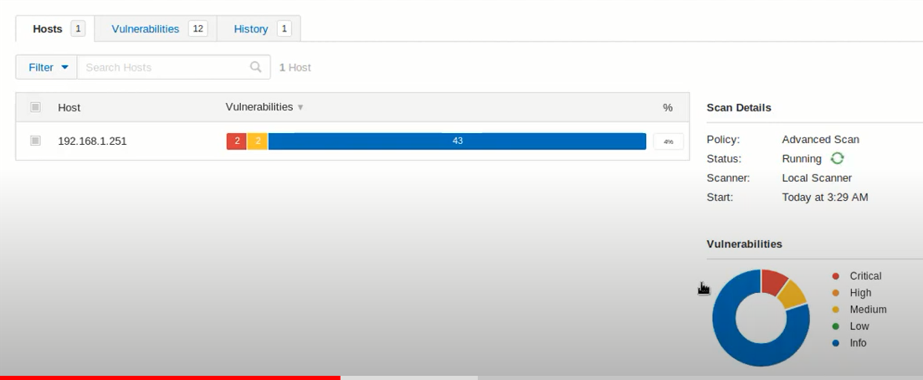
Check Vulnerabilities

Slide 23
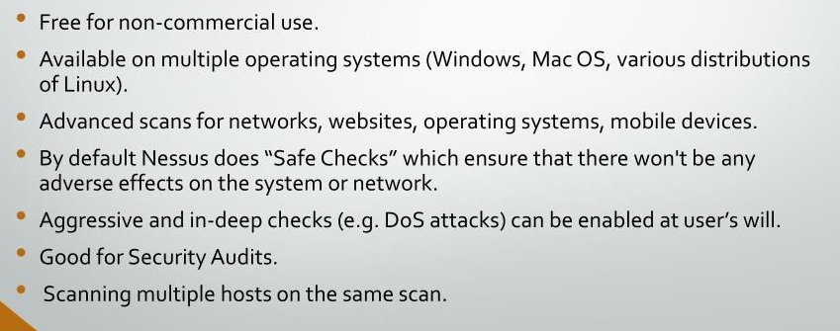
Advantages

Slide 24
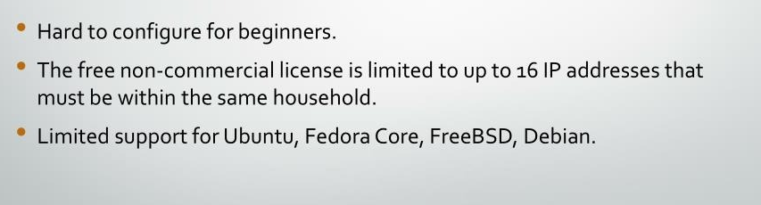
Disadvantages

Slide 25


Slide 26
Introduction
Graphical tool for performing security testing of web applications.
Support the entire testing process, from initial mapping and analysis of an application's attack surface, through to finding and exploiting security vulnerabilities.
Written in Java
Developed by PortSwigger Security.
Available in both free and professional editions.

Slide 27
Burp Suite Modules
Target
Proxy
Spider
Scanner
Intruder
Repeater

Slide 28
Target Module
Gives overview of target application’s content and functionality
It defines which targets are in scope for your current work
It drives the process of testing for vulnerabilities

Slide 29
Proxy Module
It operates as web proxy server
Man in the middle between browser and destination web servers
It lets you intercept, inspect and modify the raw traffic in both direction

Slide 30
Spider Module
It is used for automatically crawling web applications
It can be used in conjunction with manual mapping techniques to speed up the process of mapping an application’s content and functionality

Slide 31
Scanner Module
It is used for automatically finding the vulnerabilities in web applications.
Mostly used by security testers
It can fit with existing tools and techniques for performing penetration tests.

Slide 32
Intruder Module
Used for automating customized attacks against web applications
Extremely powerful and configurable
Can perform huge range of tasks from simple brute force guessing of web directories to active exploitation of complex blind SQL injection vulnerabilities.

Slide 33
Repeater Module
Used for manually manipulating and reissuing individual HTTP requests and analyzing the application’s responses.
Multipurpose tool

Slide 34
Setup and Installation
Download from PortSwinger official website
Install and import certificate from
Start scanning and Testing

Slide 35
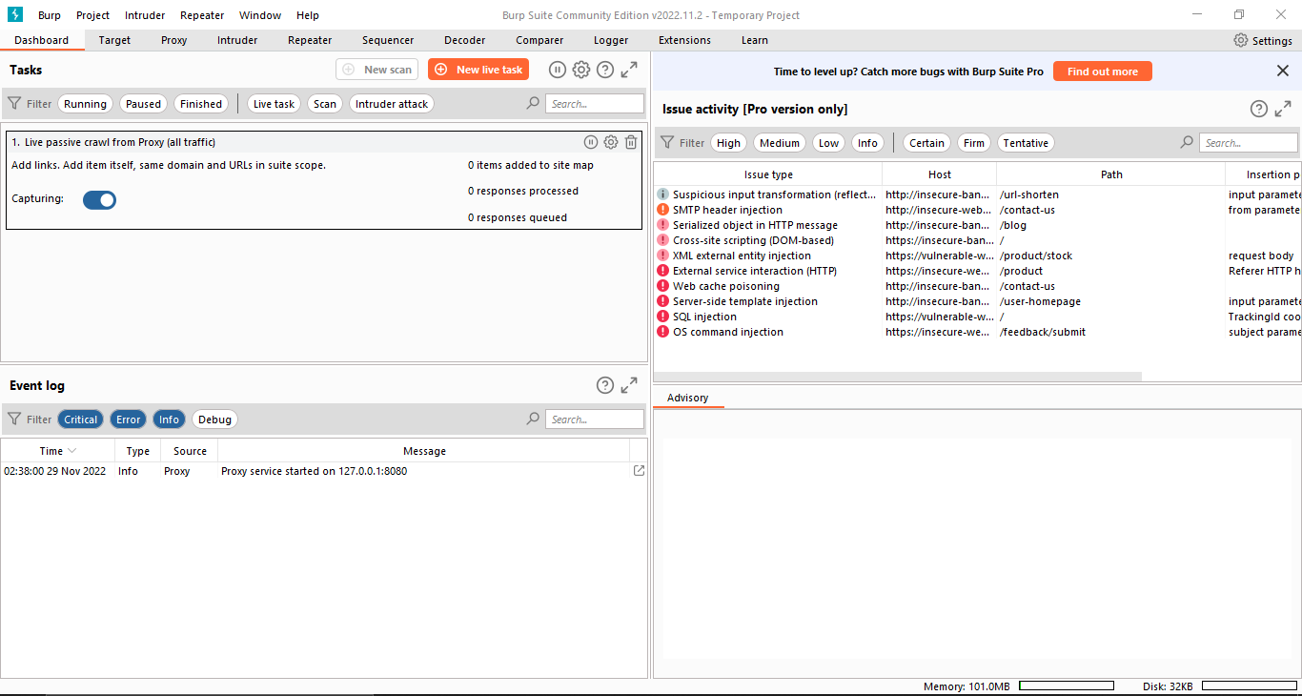
Working Demo - Dashboard

Slide 36
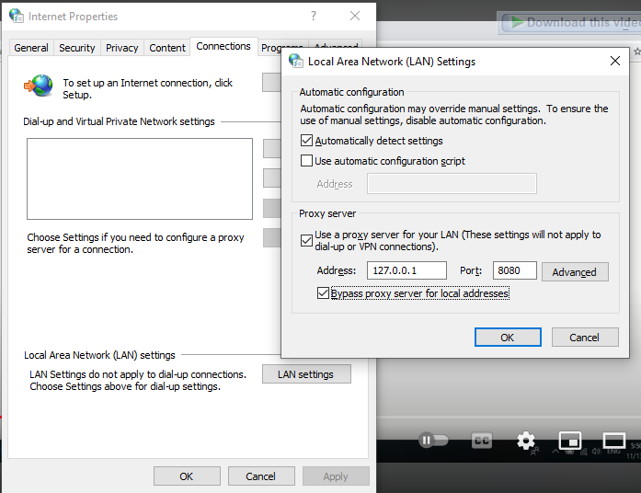
LAN Settings
Set your LAN Settings same as Burp Suite

Slide 37
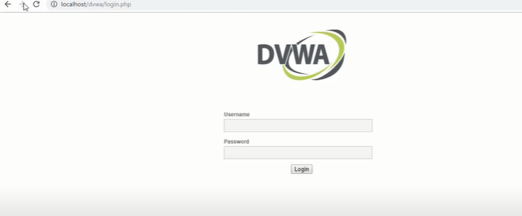
Open any vulnerable web application

Slide 38
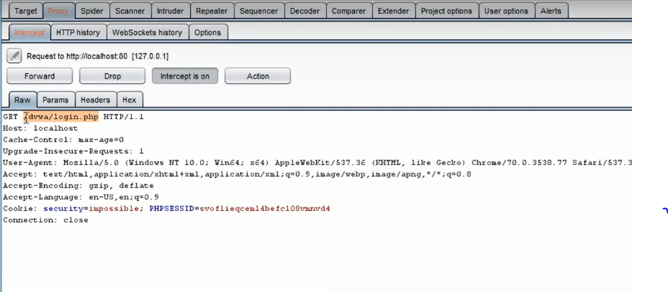
Captured Details

Slide 39
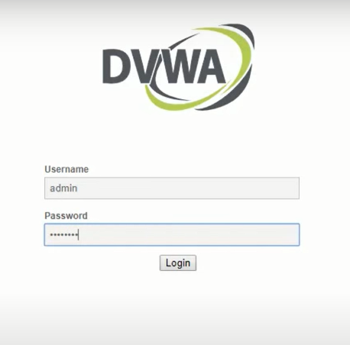
Enter some credentials

Slide 40
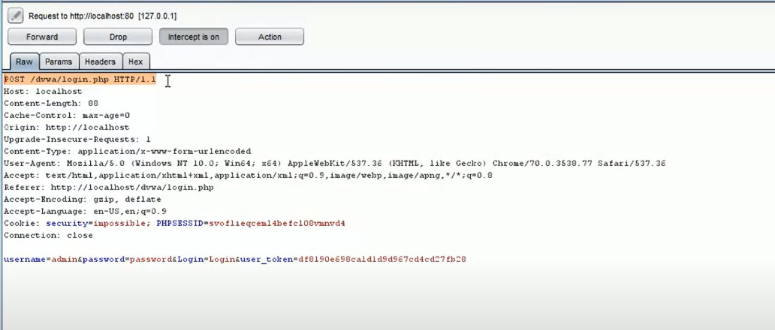
Analyze Results
Notes:
Drop or Forward Request based on analysis

Slide 41
Conclusion
Pros
Burp Suite has the most powerful tools to do web penetration testing. Burp comes with Web vulnerability scanning and fully customized scan and attack applications.
Cons
It's not easy to use, but luckily there's a lot of tutorial out there that can help the beginner to use Burp Suite.

Slide 42

That’s it !!!
Thank you.

